Slide 1

Department of Computer Science and Engineering
Artist Recommendation System using Collaborative filtering
Harshini Nandi : 17wh1a05a9
Yamini MNS : 17wh1a05a7
Akshitha Marumudi : 17wh5a0568
Internal Guide: Ms A. Kranthi
Designation : Assistant Professor

Slide 2

Abstract
Why Should I Study this course?
With commercial music streaming service which can be accessed from mobile devices, the availability of digital music currently is abundant compared to previous era. Sorting out all this digital music is a very time-consuming and causes information fatigue. Therefore, it is very useful to develop a music recommender system that can search in the music libraries automatically and suggest suitable songs to users. By using music recommender system, the music provider can predict and then offer the appropriate songs to their users based on the characteristics of the music that has been heard previously.
The project develops a music recommender system that can give recommendations based on similarity of features on audio listened by the user. This study uses convolutional recurrent neural network (CRNN) for feature extraction and similarity distance to look similarity between features. The results of this study indicate that users prefer recommendations that consider music genres compared to recommendations based solely on similarity.
Examples
BVRIT HYDERABAD College of Engineering for Women

Slide 3

What is Music Recommender System?
Recommender System is a software tool and algorithm that gives recommendations for items that is most interesting to a user. Recommendations is related to many kinds of real applications, such as what commodities are purchased, what songs is listened, or what latest news is read.
Method :
This can be done by following Collaborative Filtering.
Collaborative Filtering is a technique that can filter out items that a user might like on the basis of reactions by similar users.

Slide 4
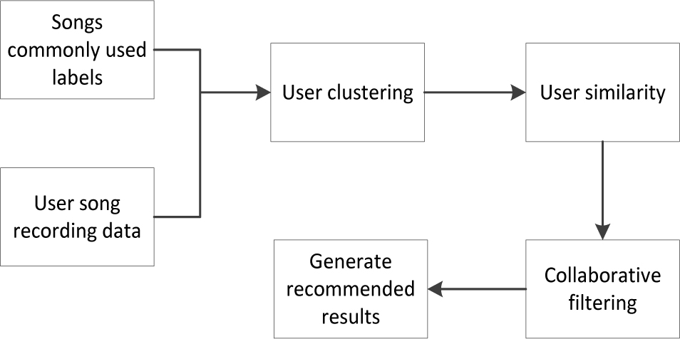
Design
Why Should I Study this course?
Examples
BVRIT HYDERABAD College of Engineering for Women

Slide 5
Dataset Source
Why Should I Study this course?
Datasets :
user_artist_data.txt
artist_alias.txt
artist_data.txt
The original data file user_artist_data.txt contained about 141,000 unique users, and 1.6 million unique artists. About 24.2 million users’ plays of artists are recorded, along with their count.
artist_alias.txt, which maps artist IDs that are known misspellings or variants to the canonical ID of that artist.
The artist_data.txt file then provides a map from the canonical artist ID to the name of the artist.
Examples
BVRIT HYDERABAD College of Engineering for Women

Slide 6
Technology Stack
Why Should I Study this course?
Pyspark
Colab
Apache Spark
Examples
BVRIT HYDERABAD College of Engineering for Women

Slide 7

Data Training
Using randomSplit function on userArtistdata dataset:
A training set, trainData, that will be used to train the model. This set should constitute 40% of the data.
A validation set, validationData, used to perform parameter tuning. This set should constitute 40% of the data.
A test set, testData, used for a final evaluation of the model. This set should constitute 20% of the data.

Slide 8
Model Evaluation
This model can be used to predict the top X artist recommendations for a user and these recommendations can be compared the artists that the user actually listened to.
Then, the fraction of overlap between the top X predictions of the model and the X artists that the user actually listened to can be calculated.
This process can be repeated for all users and an average value returned.

Slide 9
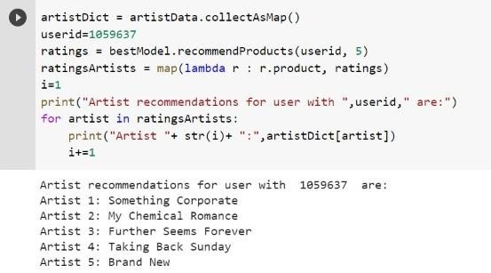
Output

Slide 10
References
RUI CHEN 1,2, QINGYI HUA1 , YAN-SHUO CHANG3 , BO WANG1,4, LEI ZHANG5 , AND XIANGJIE KONG 6 , (Senior Member, IEEE)), Collaborative Filtering-Based Recommender Systems, IEEE Conference in 2018. (Base paper)
Deldjoo Y, Cremonesi P, Schedl M, Quadrana M The effect of different video summarization models on the quality of video recommendation based on low-level visual features. (2017).
Lee JH, Wishkoski R, Aase L, Meas P, Hubbles C Understanding users of cloud music services: selection factors, management and access behavior, and perceptions. (2017)
Schäfer T, Mehlhorn C Can personality traits predict musical style preferences? A meta-analysis. (2017)
I. Portugal, P. Alencar, and D. Cowan, ‘‘The use of machine learning algorithms in recommender systems: A systematic review,’’ Expert Syst. Appl., vol. 97, pp. 205–227, Dec. 2018.

Slide 11
Thank you

